Slide 1




Problem Statement Title: FALSE URGENCY
Team Name: Codelquisitors
Team Leader Name: YASHRAJ VERMA Institute Name: Ramaiah Institute of Technology Bengaluru

Slide 2
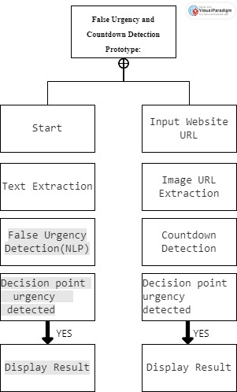
Idea/Approach Details
1. False Urgency Detection (NLP-based):
Utilizes natural language processing to analyze text content on websites.
Uses a machine learning model trained on labeled data to identify patterns associated with false urgency.
Tokenization, feature extraction, and a simple classification model (e.g., Naive Bayes) are used.
2. Countdown Detection (Image-based):
Employs computer vision techniques for image classification to detect countdowns in images.
A Convolutional Neural Network (CNN) model is trained on a dataset containing images of countdowns and non-countdowns.
The model learns to classify whether an image contains a countdown or not.

Slide 3
Idea/Approach Details
Describe your Use Cases here
Describe your Dependencies / Show stopper here
E-commerce Platforms
Digital Marketing Campaigns
News and Information Websites
Travel and Booking Websites
Online Events and Ticket Sales
Online Auctions
Subscription Services
Financial Services Websites
Online Courses and Training Platforms
Real Estate Listings
Job Posting Platforms
Charitable Donations Websites
Gaming and Entertainment Platforms
Health and Wellness Products
Online Auctions (Art and Collectibles)
Government and Public Service Websites
Technical Dependencies:
1. Web Scraping Tools:
Dependency on robust web scraping tools (e.g., BeautifulSoup, Selenium) to extract text content and images from websites.
2. NLP Libraries:
Reliance on natural language processing libraries (e.g., NLTK, spaCy) for text analysis and false urgency detection.
3. Computer Vision Libraries:
Dependency on computer vision libraries (e.g., TensorFlow, Keras) for image processing and countdown detection.
4. Machine Learning Frameworks:
Utilization of machine learning frameworks for model training and prediction (e.g., scikit-learn for NLP, TensorFlow for image classification).

Slide 4
Showstoppers:
1. Accuracy and Reliability:
The prototype's effectiveness heavily depends on the accuracy and reliability of the false urgency detection model and the image classification model. Poor performance may hinder the utility of the tool.
2. Real-Time Analysis:
If real-time analysis is a requirement, the speed of web scraping and model predictions must be optimized to provide timely results.
3. Adaptability to Website Changes:
Websites frequently update their layouts and structures. The prototype must be robust enough to adapt to changes in website design without breaking.
4. User Interface (UI):
The lack of a user-friendly interface for users who are not familiar with technical details might limit the accessibility and usability of the prototype.
5. Security Concerns:
Addressing potential security concerns associated with web scraping, especially if the prototype is handling sensitive information.

Slide 5
Team Member Details
Team Leader Name: Type YASHRAJ VERMA
Branch (Btech/Mtech/PhD etc): AI&DS Stream (ECE, CSE etc):AI&DS Year (I,II,III,IV): 3
Team Member 1 Name: Type AMRUT K.
Branch (Btech/Mtech/PhD etc): AI&DS Stream (ECE, CSE etc):AI&DS Year (I,II,III,IV): 3
Team Mentor 1 Name: Type SOUMYA B.J
Category (Academic/Industry): Acadmeic Expertise (AI/ML/Blockchain etc):Data Science Domain Experience (in years): 5+

Slide 6
Important Pointers
Please ensure below pointers are met while
Kindly keep the maximum slides limit to 6 pages
All the topics should be utilized for description of your idea
Try to avoid paragraphs and post your idea in points
Keep your explanation precisely and easy to understand
Idea should be unique and novel. If it has a business potential more weightage will be given.
Apart from this PPT abstract of your idea will be asked separately while submitting
You can delete this slide (Important Pointers) when you upload the details of your idea on SIH portal.

